Slide 1
Words from Learner agreement

Slide 2
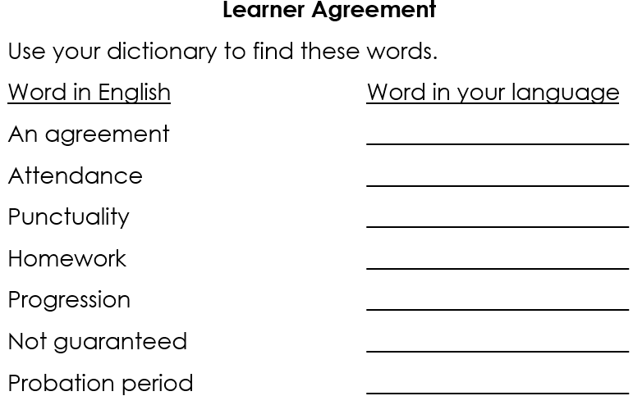

Slide 3
An agreement
Amharic: አስተማማኝ
Arabic: اتفاق
Cantonese: 協議
Dari: توافق
Farsi: توافق
French: Un accord
Hindi: एक समझौता
Kurdish (Kurmanji): Peyman
Kurdish (Sorani): پەیمان
Lithuanian: Susitarimas
Lingala: Bokutani
Mandarin: 协议
Nepali: सम्झौता
Portuguese: Um acordo
Romanian: Un acord
Russian: Соглашение
Pashto: تړون
Polish: Umowa
Punjabi: ਇਕ ਸਮਝੌਤਾ
Somali: Heshiis

Slide 4
Spanish: Un acuerdo
Swahili: Makubaliano
Tamil: ஒப்பந்தம்
Thai: ข้อตกลง
Tigrinya: ምምሕዳር
Tigre: ምምሕዳር
Urdu: ایک معاہدہ
Ukrainian: Угода
Vietnamese: Một thỏa thuận
Welsh: Cytundeb
Yoruba: Adehun

Slide 5
Attendance
Amharic: መገኘት
Arabic: حضور
Cantonese: 出席
Dari: حضور
Farsi: حضور
French: Présence
Hindi: उपस्थिति
Kurdish (Kurmanji): Tevlîbûn
Kurdish (Sorani): حەضوور
Lithuanian: Dalyvavimas
Lingala: Bokutani
Mandarin: 出席
Nepali: उपस्थिति
Portuguese: Presença
Romanian: Prezență
Russian: Посещаемость
Pashto: حاضري
Polish: Frekwencja
Punjabi: ਹਾਜ਼ਰੀ
Somali: Joogitaan

Slide 6
Spanish: Asistencia
Swahili: Mahudhurio
Tamil: வருகை
Thai: การเข้าร่วม
Tigrinya: ምግባር
Tigre: ምግባር
Urdu: حاضری
Ukrainian: Відвідуваність
Vietnamese: Sự tham dự
Welsh: Presenoldeb
Yoruba: Wiwa

Slide 7
Punctuality
Amharic: ጊዜ መጠበቅ
Arabic: دقة المواعيد
Cantonese: 準時
Dari: وقت شناسی
Farsi: وقت شناسی
French: Ponctualité
Hindi: समय की पाबंदी
Kurdish (Kurmanji): Demjimar
Kurdish (Sorani): کاتی
Lithuanian: Punktualumas
Lingala: Bokutani na ngonga
Mandarin: 准时
Nepali: समयपालन
Portuguese: Pontualidade
Romanian: Punctualitate
Russian: Пунктуальность
Pashto: وخت پابندي
Polish: Punktualność
Punjabi: ਸਮੇਂ ਦੀ ਪਾਬੰਦੀ
Somali: Waqti

Slide 8
Spanish: Puntualidad
Swahili: Uaminifu
Tamil: நேர்த்தி
Thai: ความตรงต่อเวลา
Tigrinya: ጊዜ መጠበቅ
Tigre: ጊዜ መጠበቅ
Urdu: وقت کی پابندی
Ukrainian: Пунктуальність
Vietnamese: Đúng giờ
Welsh: Prydferthwch
Yoruba: Akoko

Slide 9
Homework
Amharic: የቤት ስራ
Arabic: واجب منزلي
Cantonese: 家庭作業
Dari: کار خانگی
Farsi: تکلیف خانه
French: Devoirs
Hindi: गृहकार्य
Kurdish (Kurmanji): Karê malê
Kurdish (Sorani): کارەخانە
Lithuanian: Namų darbai
Lingala: Mosala ya ndako
Mandarin: 家庭作业
Nepali: गृहकार्य
Portuguese: Tarefa de casa
Romanian: Temă pentru acasă
Russian: Домашнее задание
Pashto: کورنۍ دنده
Polish: Praca domowa
Punjabi: ਘਰ ਦਾ ਕੰਮ
Somali: Shaqo guri

Slide 10
Spanish: Tarea
Swahili: Kazi ya nyumbani
Tamil: வீட்டுப்பாடம்
Thai: การบ้าน
Tigrinya: የቤት ስራ
Tigre: የቤት ስራ
Urdu: ہوم ورک
Ukrainian: Домашнє завдання
Vietnamese: Bài tập về nhà
Welsh: Gwaith cartref
Yoruba: Iṣẹ ile

Slide 11
Progression
Amharic: እድገት
Arabic: تقدم
Cantonese: 進展
Dari: پیشرفت
Farsi: پیشرفت
French: Progression
Hindi: प्रगति
Kurdish (Kurmanji): Pêşveçûn
Kurdish (Sorani): پێشەنگی
Lithuanian: Progresas
Lingala: Bokutani
Mandarin: 进展
Nepali: प्रगति
Portuguese: Progressão
Romanian: Progres
Russian: Прогресс
Pashto: پرمختګ
Polish: Postęp
Punjabi: ਤਰੱਕੀ
Somali: Horumar

Slide 12
Spanish: Progreso
Swahili: Maendeleo
Tamil: முன்னேற்றம்
Thai: ความก้าวหน้า
Tigrinya: እድገት
Tigre: እድገት
Urdu: ترقی
Ukrainian: Прогрес
Vietnamese: Tiến bộ
Welsh: Cynnydd
Yoruba: Ilọsiwaju

Slide 13
Not guaranteed
Amharic: አልተረጋገጠም
Arabic: غير مضمون
Cantonese: 不保證
Dari: تضمین نشده
Farsi: تضمین نشده
French: Non garanti
Hindi: गारंटी नहीं
Kurdish (Kurmanji): Ne piştrast kirin
Kurdish (Sorani): بێپەیوەندی
Lithuanian: Ne garantuotas
Lingala: Te garanti
Mandarin: 不保证
Nepali: ग्यारेन्टी छैन
Portuguese: Não garantido
Romanian: Nu este garantat
Russian: Не гарантировано
Pashto: تضمین نه دی
Polish: Nie gwarantowane
Punjabi: ਗਾਰੰਟੀ ਨਹੀਂ
Somali: Ma hubo

Slide 14
Spanish: No garantizado
Swahili: Haijathibitishwa
Tamil: உத்தரவாதம் இல்லை
Thai: ไม่รับประกัน
Tigrinya: አይታረጋገጥም
Tigre: አይታረጋገጥም
Urdu: ضمانت نہیں
Ukrainian: Не гарантовано
Vietnamese: Không được đảm bảo
Welsh: Ddim yn gwarantu
Yoruba: Ko ni idaniloju

Slide 15
Probation period
Amharic: የሙከራ ጊዜ
Arabic: فترة التجربة
Cantonese: 試用期
Dari: دوره آزمایشی
Farsi: دوره آزمایشی
French: Période d'essai
Hindi: परिवीक्षा अवधि
Kurdish (Kurmanji): Demê probasyonê
Kurdish (Sorani): ماوەی تاقیکردنەوە
Lithuanian: Bandomasis laikotarpis
Lingala: Période ya esayi
Mandarin: 试用期
Nepali: परीक्षण अवधि
Portuguese: Período de prova
Romanian: Perioada de probă
Russian: Испытательный срок
Pashto: د ازموینې دوره
Polish: Okres próbny
Punjabi: ਪਰਖ ਦਾ ਸਮਾਂ
Somali: Mudada tijaabada

Slide 16
Spanish: Período de prueba
Swahili: Kipindi cha majaribio
Tamil: பரீட்சை காலம்
Thai: ระยะทดลองงาน
Tigrinya: የሙከራ ጊዜ
Tigre: የሙከራ ጊዜ
Urdu: آزمائشی مدت
Ukrainian: Випробувальний термін
Vietnamese: Thời gian thử việc
Welsh: Cyfnod prawf
Yoruba: Akoko idanwo

Slide 17

Fill the gap with the correct word.
You must sign the Learner ______________ when you start college.
If your ______________ is good it means you are not usually late for your class.
Your _______________ is good if you come to all your classes. If you miss classes your _____________ will be bad.
You must do your ______________ every week.
Your _______________ will be to Entry 2 if you pass all your exams.
Your attendance must be good to pass the ___________ ____________.
Progression to Entry 2 is __________ ____________. You must pass your class tests to progress.
agreement
puntuality
attendance
attendance
homework
progression
probation
period
not
guaranteed

